Slide 1
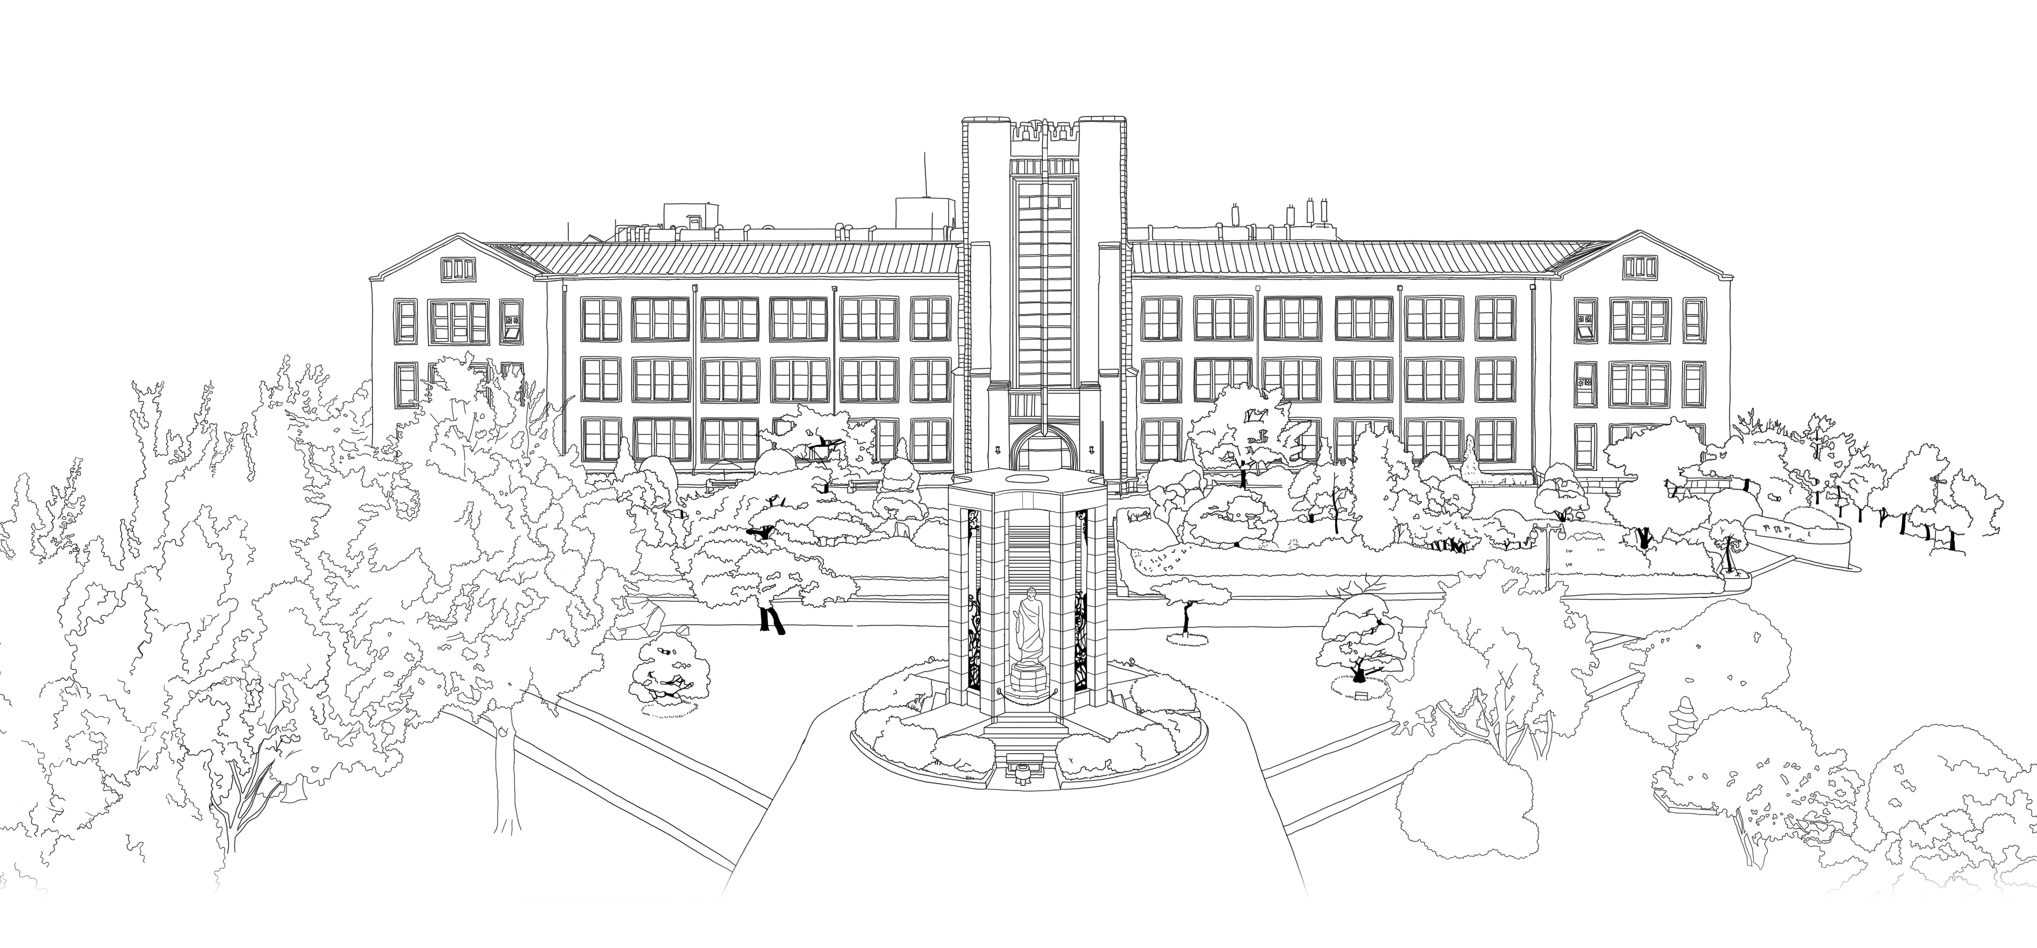


Introduction to Algorithms
DongYeon Kim
Department of Multimedia Engineering
Dongguk University

Slide 2
Contents
Chapter.3 Data Structures
Elementary Data Structures
Stacks and queues
Linked lists
Implementing pointers and objects
Representing rooted trees
Hash Tables
Direct-address tables
Hash tables
Hash functions
Open addressing
Binary Search Trees
What is a binary search tree?
Querying a binary search tree
Insertion and deletion
Red-Black Trees
Properties of red-black trees
Rotations
Insertion
Deletion
Augmenting Data Structures
Dynamic order statistics
How to augment a data structure
Interval trees

Slide 3
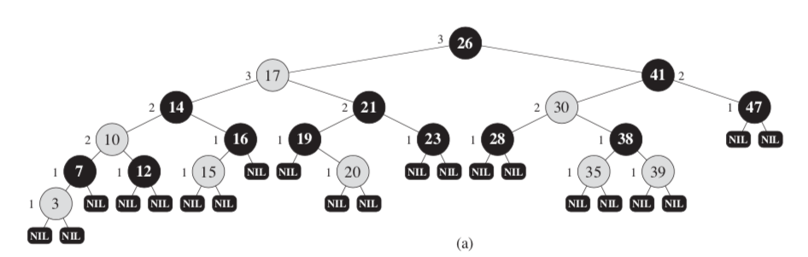
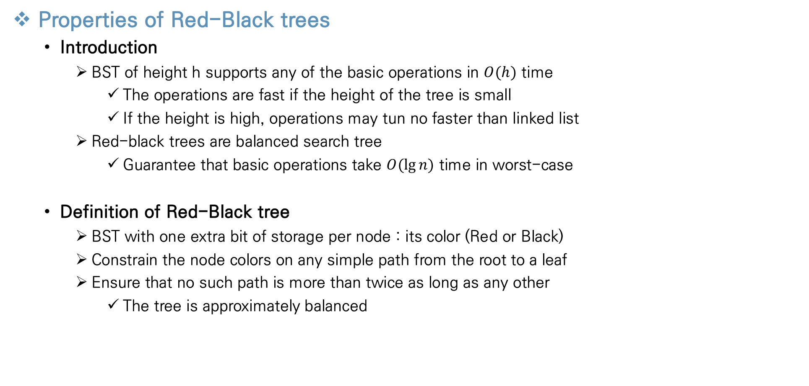
Red-Black Trees
Properties of Red-Black trees
Introduction
BST of height h supports any of the basic operations in $O(h)$ time
The operations are fast if the height of the tree is small
If the height is high, operations may tun no faster than linked list
Red-black trees are balanced search tree
Guarantee that basic operations take $O(\lg{n})$ time in worst-case
Definition of Red-Black tree
BST with one extra bit of storage per node : its color (Red or Black)
Constrain the node colors on any simple path from the root to a leaf
Ensure that no such path is more than twice as long as any other
The tree is approximately balanced

Slide 4
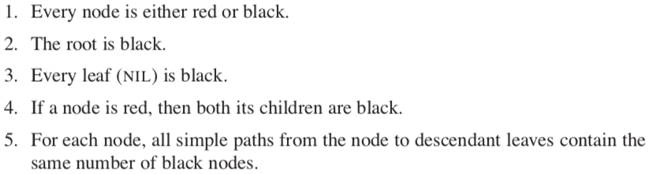
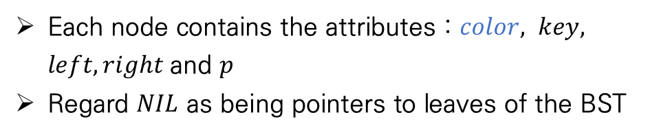
Red-Black Trees
Properties of Red-Black trees
Definition of Red-Black tree
Red-black tree properties
Each node contains the attributes : $color, key, left, right$and $p$
Regard $NIL$ as being pointers to leaves of the BST

Slide 5
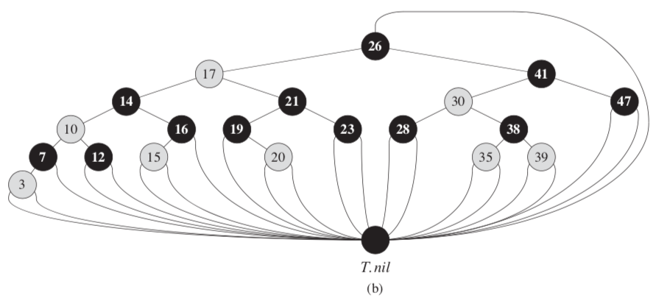
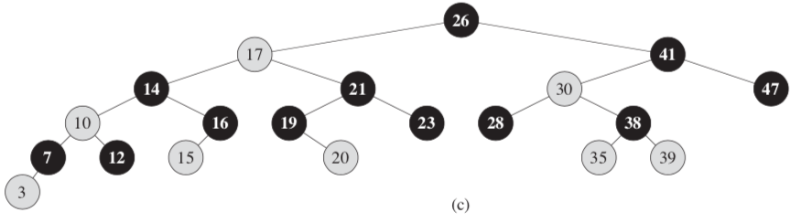
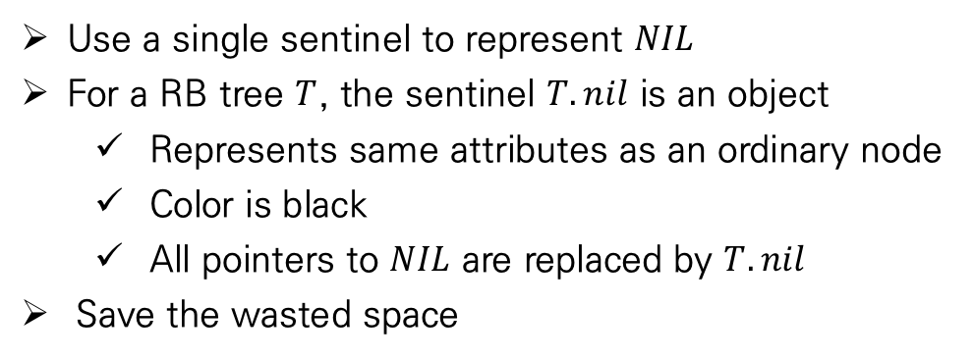
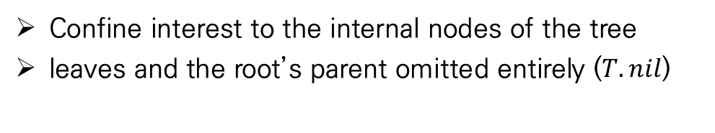
Red-Black Trees
Properties of Red-Black trees
Single sentinel Red-Black tree
Simple Red-black tree
Use a single sentinel to represent $NIL$
For a RB tree $T$, the sentinel $T.nil$ is an object
Represents same attributes as an ordinary node
Color is black
All pointers to $NIL$ are replaced by $T.nil$
Save the wasted space
Confine interest to the internal nodes of the tree
leaves and the root’s parent omitted entirely ($T.nil$)

Slide 6
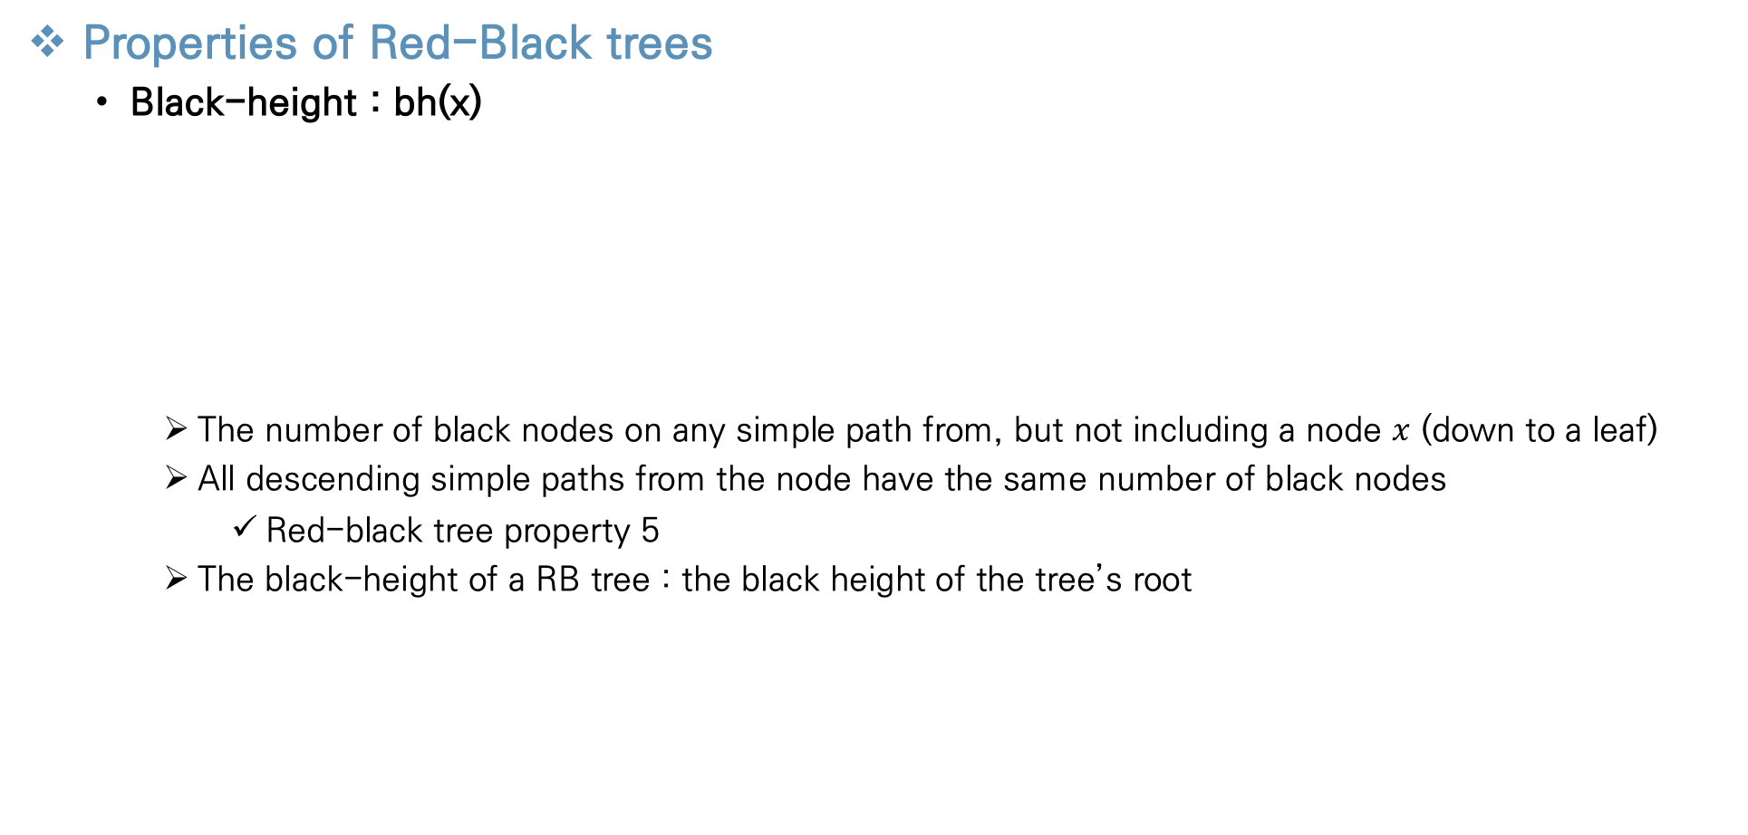
Red-Black Trees
Properties of Red-Black trees
Black-height : bh(x)
The number of black nodes on any simple path from, but not including a node $x$ (down to a leaf)
All descending simple paths from the node have the same number of black nodes
Red-black tree property 5
The black-height of a RB tree : the black height of the tree’s root

Slide 7
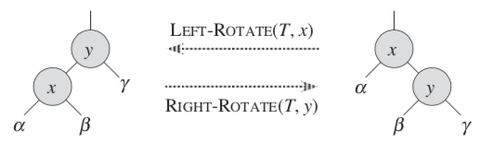
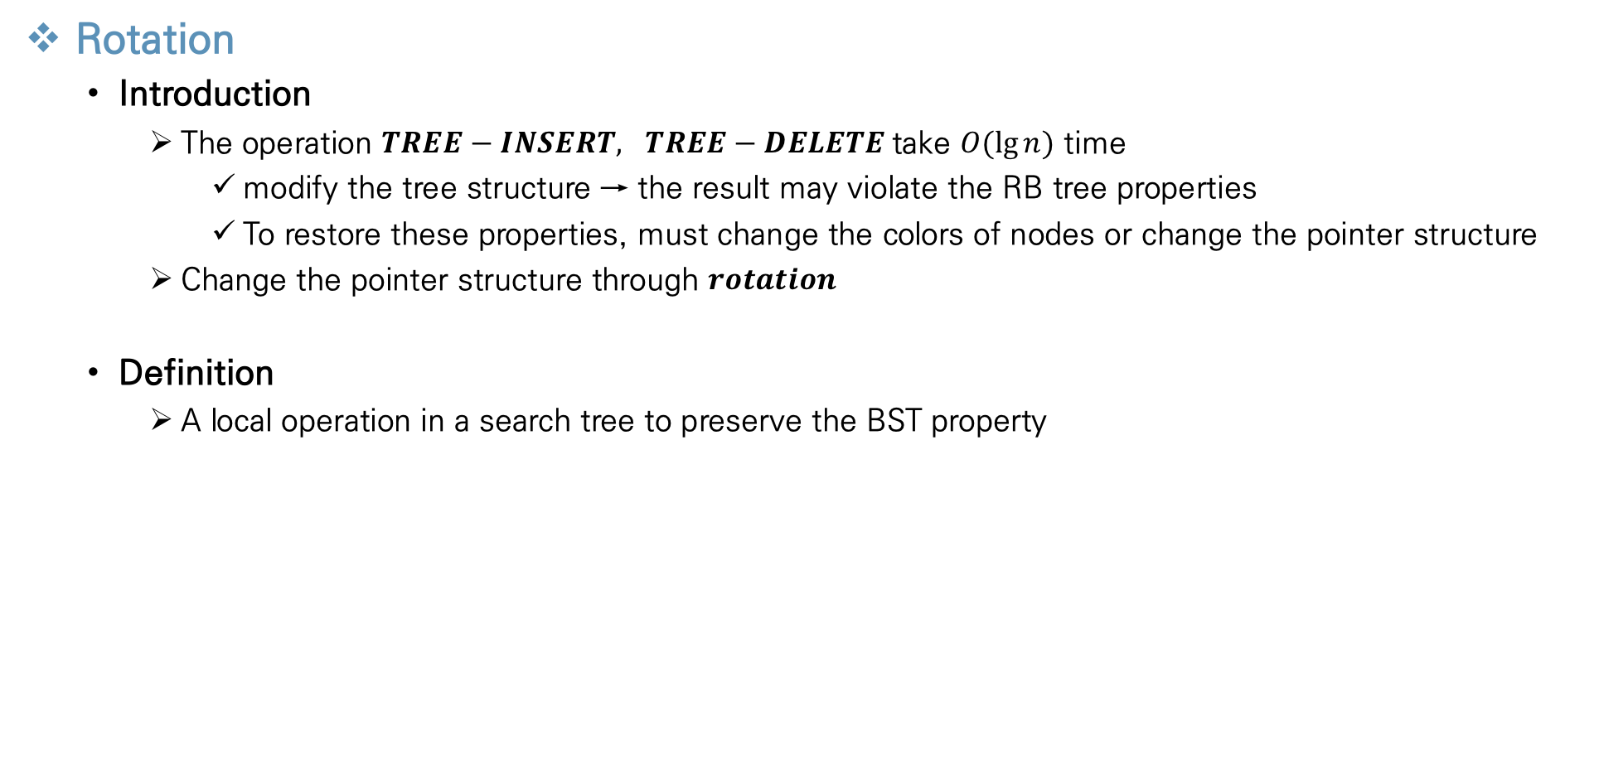
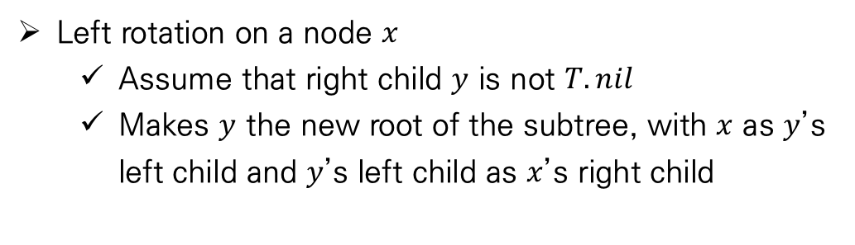
Red-Black Trees
Rotation
Introduction
The operation $TREE−INSERT, TREE−DELETE$take $O(\lg{n})$ time
modify the tree structure → the result may violate the RB tree properties
To restore these properties, must change the colors of nodes or change the pointer structure
Change the pointer structure through $rotation$
Definition
A local operation in a search tree to preserve the BST property
Left rotation on a node $x$
Assume that right child $y$ is not $T.nil$
Makes $y$ the new root of the subtree, with $x$ as $y$’s left child and $y$’s left child as $x$’s right child

Slide 8
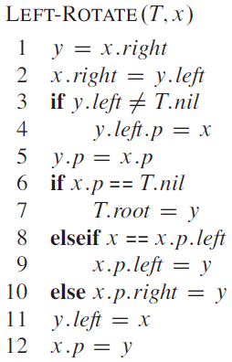
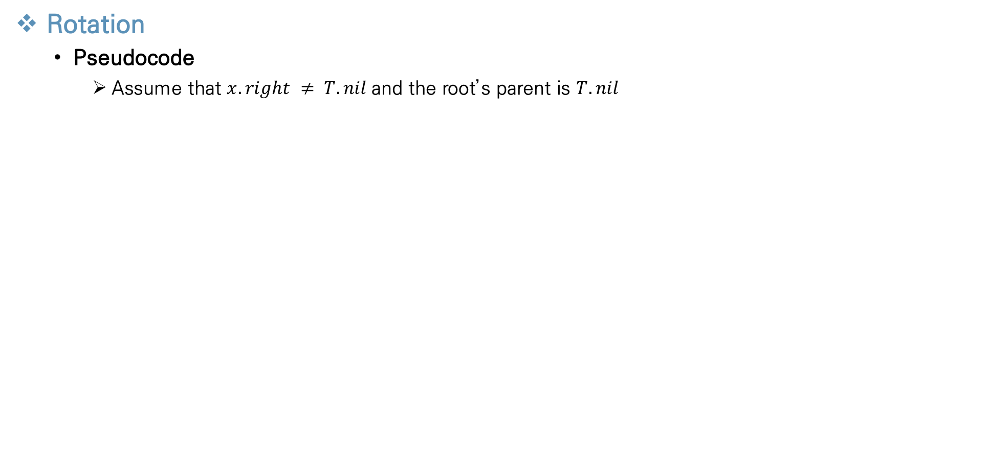
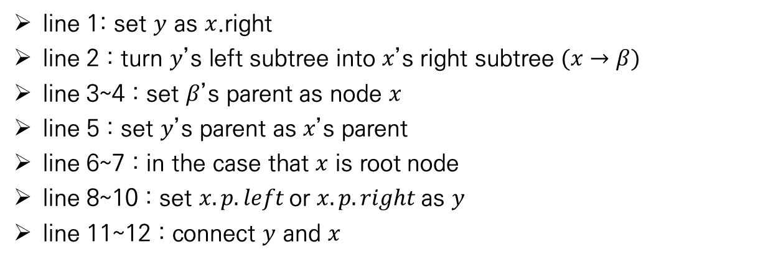
Red-Black Trees
Rotation
Pseudocode
Assume that $x.right ≠ T.nil$and the root’s parent is $T.nil$
line 1: set $y$ as $x$.right
line 2 : turn $y$’s left subtree into $x$’s right subtree $(x→β)$
line 3~4 : set $β$’s parent as node $x$
line 5 : set $y$’s parent as $x$’s parent
line 6~7 : in the case that $x$ is root node
line 8~10 : set $x.p.left$or $x.p.right$as $y$
line 11~12 : connect $y$ and $x$

Slide 9
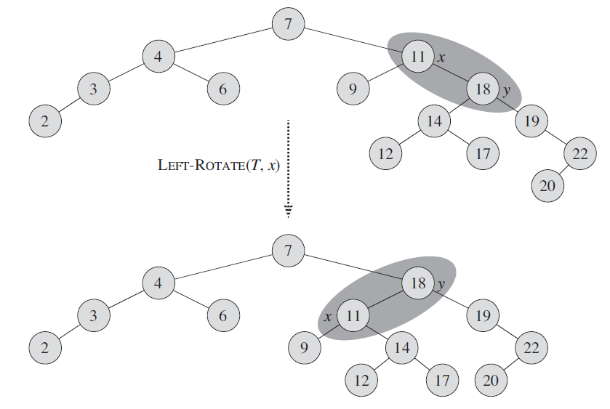
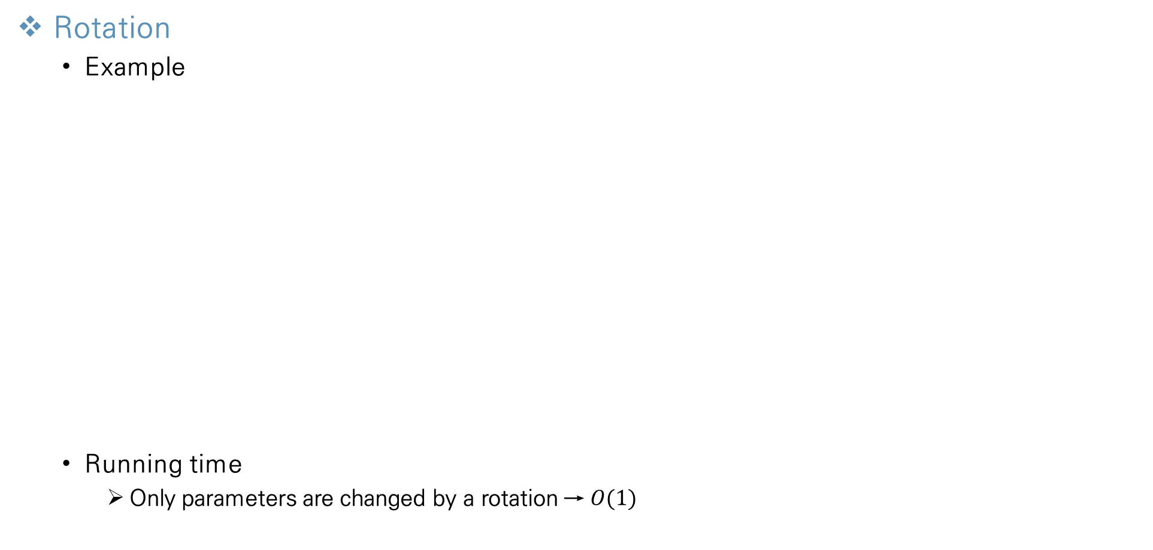
Red-Black Trees
Rotation
Example
Running time
Only parameters are changed by a rotation → $O(1)$
1
5,10
11~12
2~4

Slide 10
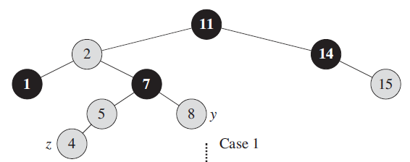
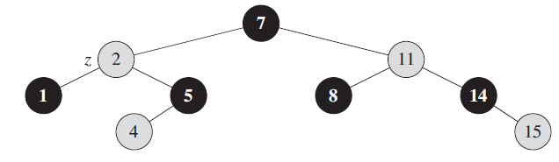



Red-Black Trees
Insertion
$RB−INSERT$
Can insert a node into an n-node red-black tree in $O(\lg{n})$ time
Insert node $z$ into the tree $T$ as if it were an BST
after inserting, color the node $z$ to red
Use a modified $TREE−INSERT$ procedure
To guarantee that the RB tree properties are preserved, call auxiliary procedure $RB−INSERT−FIXUP$ to recolor nodes and perform rotations
$$RB−INSERT$$
$$RB−INSERT−FIXUP$$

Slide 11
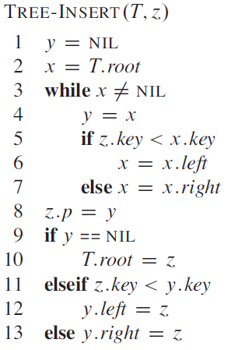
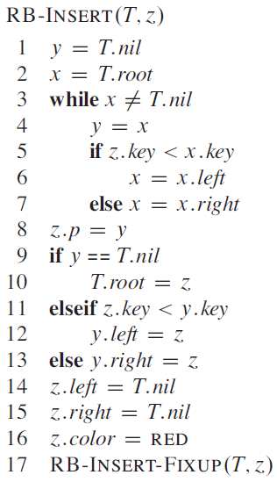

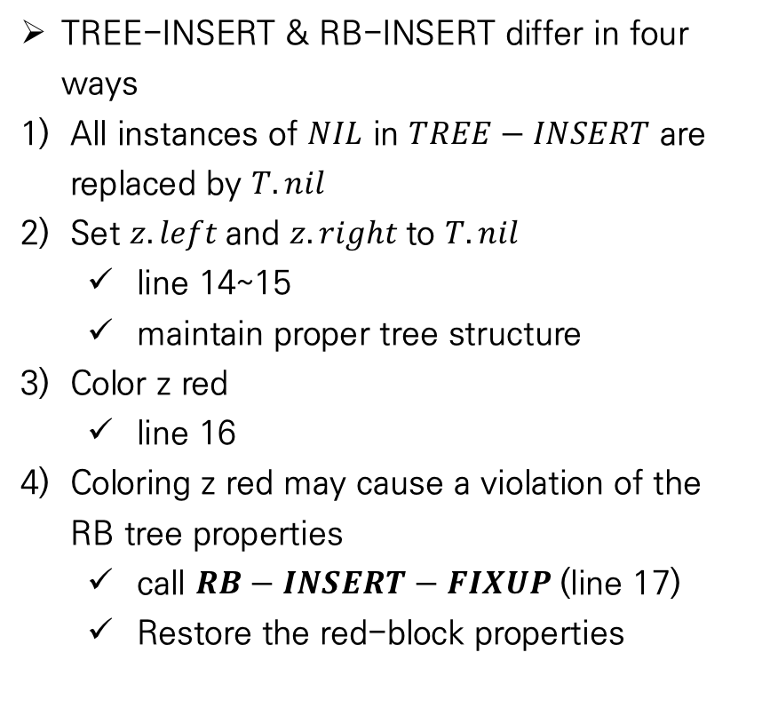
Red-Black Trees
Insertion
$RB−INSERT$ - Pseudocode
TREE-INSERT & RB-INSERT differ in four ways
All instances of $NIL$ in $TREE−INSERT$ are replaced by $T.nil$
Set $z.left$and $z.right$to $T.nil$
line 14~15
maintain proper tree structure
Color z red
line 16
Coloring z red may cause a violation of the RB tree properties
call $RB−INSERT−FIXUP$(line 17)
Restore the red-block properties

Slide 12
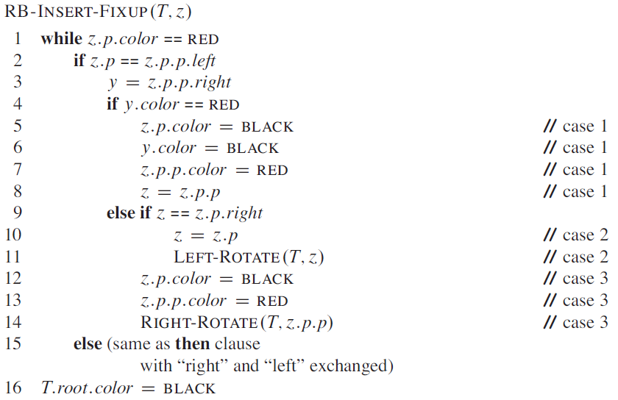

Red-Black Trees
Insertion
$RB−INSERT−FIXUP$
To understand how $RB−INSERT−FIXUP$ works, break examination of the code into three major steps
Determine what violations of the RB tree properties are introduced
Examine the overall goal of the while loop in line 1~15
Loop invariant
Explore each of three cases within the while loop’s body and how they accomplish the goal

Slide 13
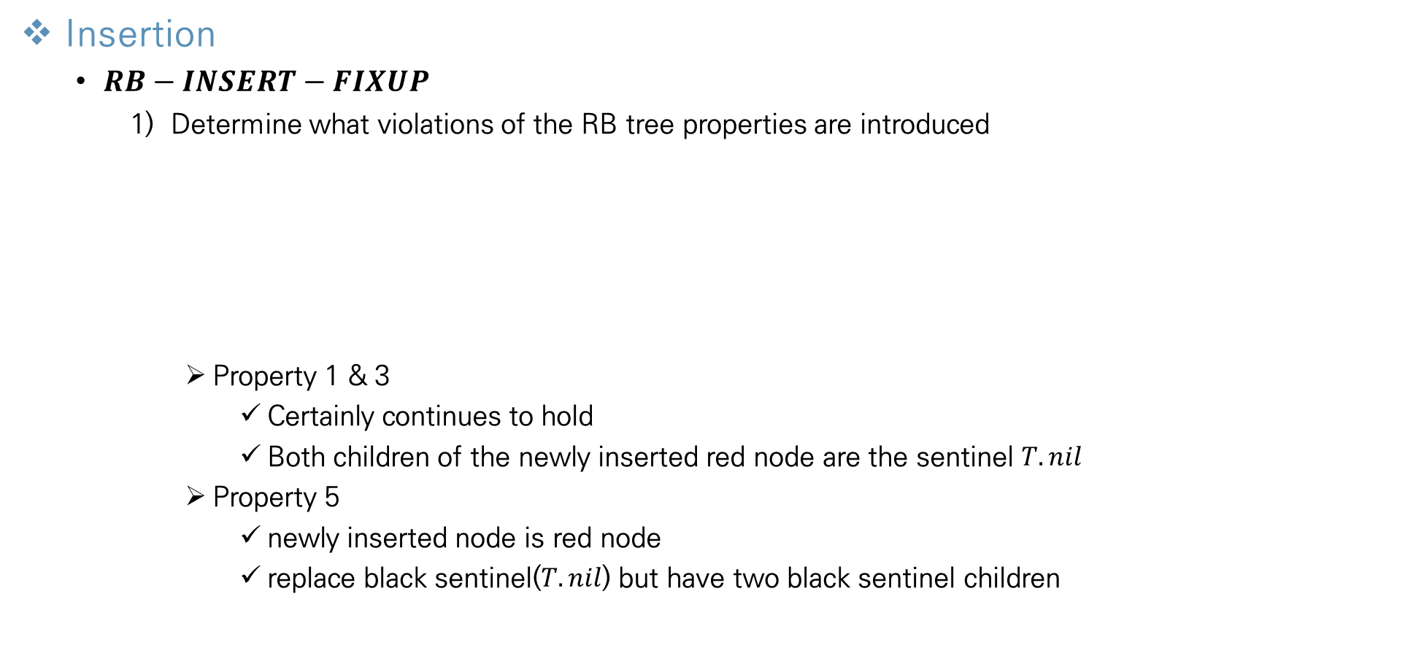
Red-Black Trees
Insertion
$RB−INSERT−FIXUP$
Determine what violations of the RB tree properties are introduced
Property 1 & 3
Certainly continues to hold
Both children of the newly inserted red node are the sentinel $T.nil$
Property 5
newly inserted node is red node
replace black sentinel($T.nil$) but have two black sentinel children
The only properties that might be violated are property 2 and 4 → due to z being colored red

Slide 14
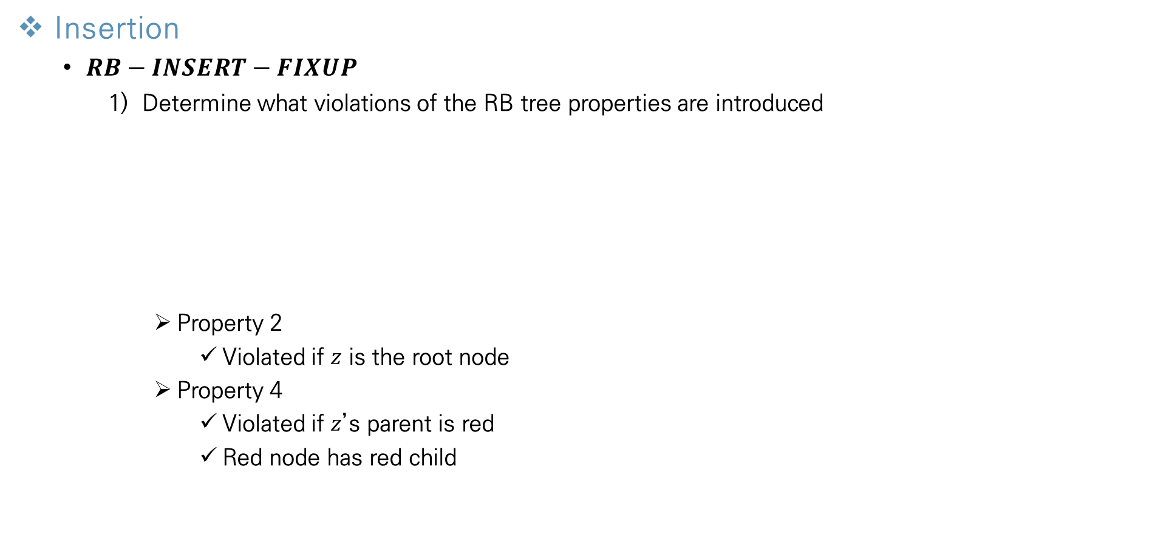
Red-Black Trees
Insertion
$RB−INSERT−FIXUP$
Determine what violations of the RB tree properties are introduced
Property 2
Violated if $z$ is the root node
Property 4
Violated if $z$’s parent is red
Red node has red child

Slide 15
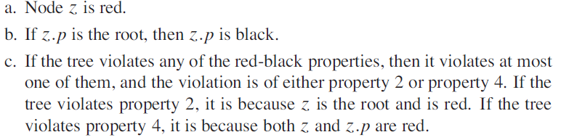
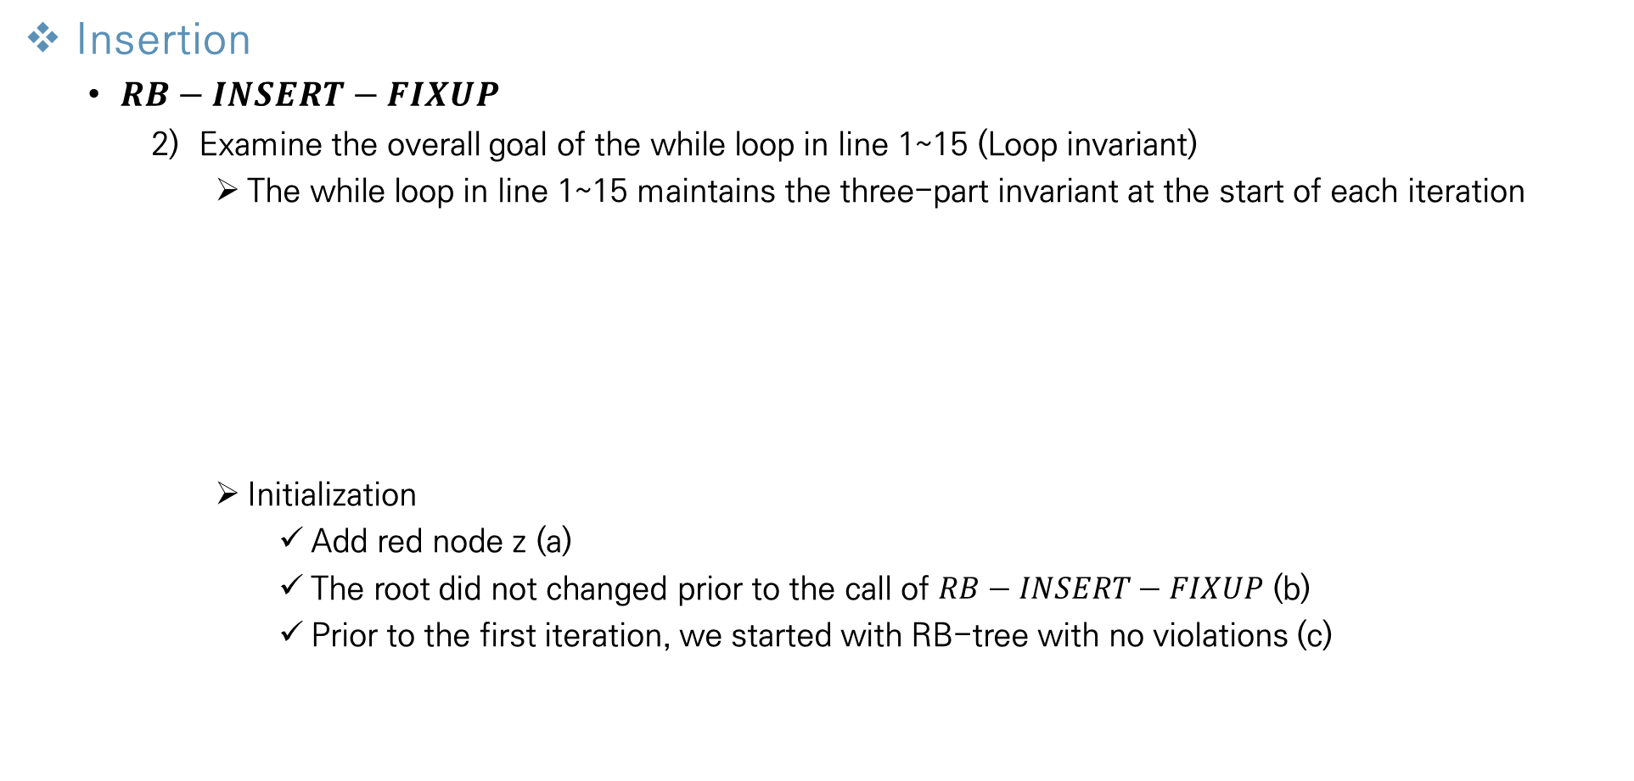
Red-Black Trees
Insertion
$RB−INSERT−FIXUP$
Examine the overall goal of the while loop in line 1~15 (Loop invariant)
The while loop in line 1~15 maintains the three-part invariant at the start of each iteration
Initialization
Add red node z (a)
The root did not changed prior to the call of $RB−INSERT−FIXUP$ (b)
Prior to the first iteration, we started with RB-tree with no violations (c)
About violations

Slide 16
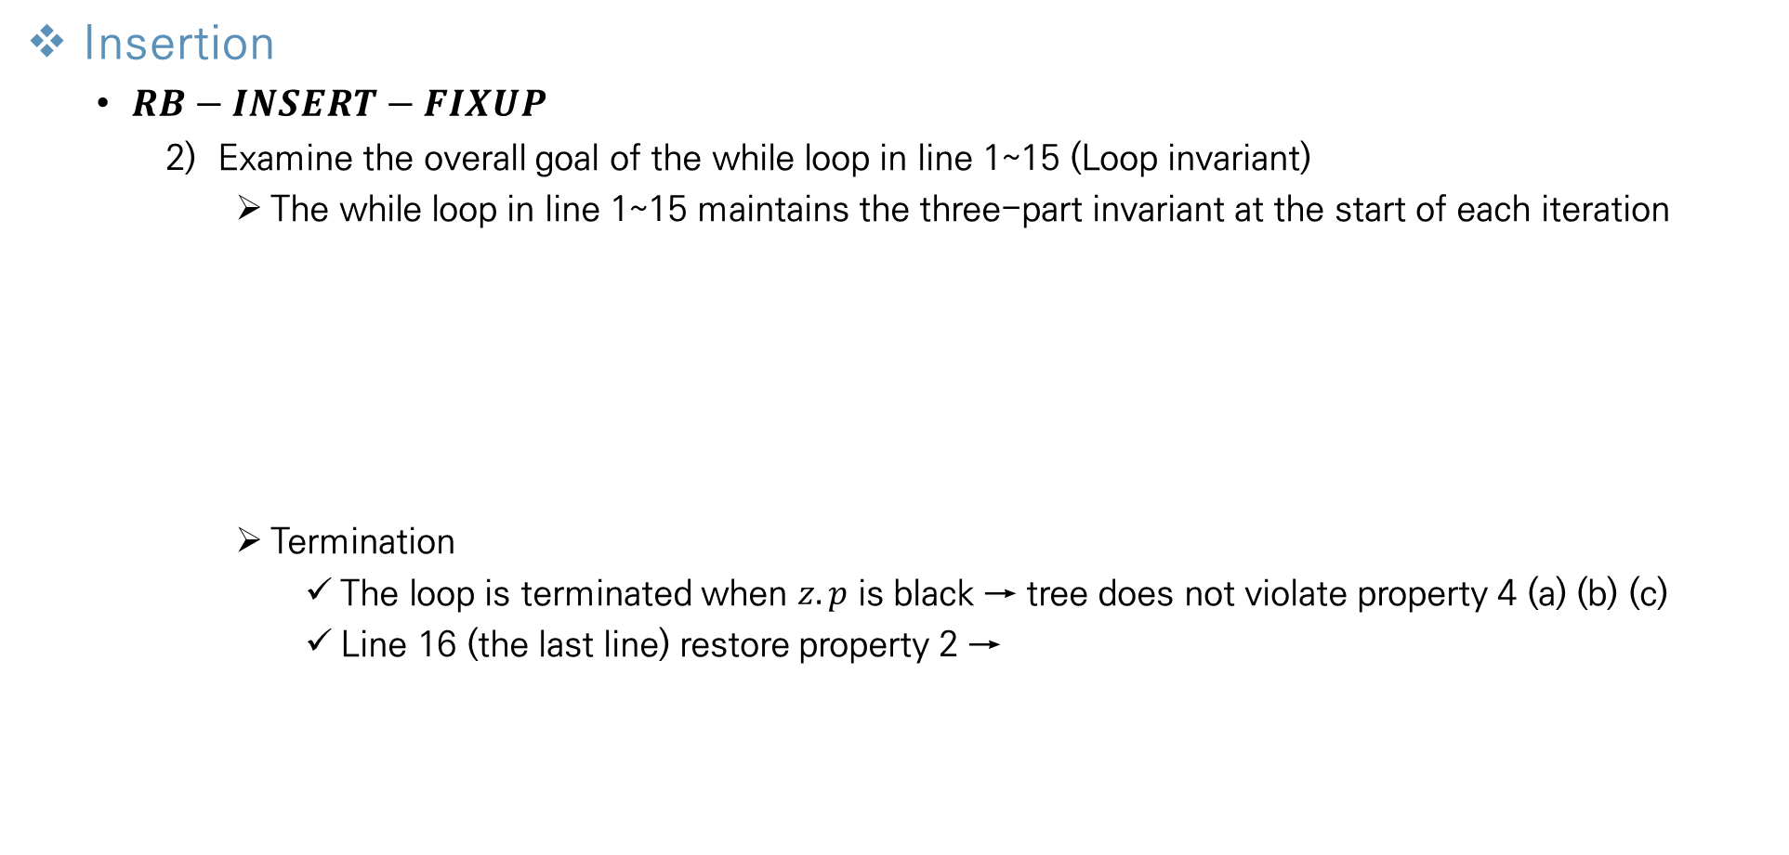
Red-Black Trees
Insertion
$RB−INSERT−FIXUP$
Examine the overall goal of the while loop in line 1~15 (Loop invariant)
The while loop in line 1~15 maintains the three-part invariant at the start of each iteration
Termination
The loop is terminated when $z.p$ is black → tree does not violate property 4 (a) (b) (c)
Line 16 (the last line) restore property 2 →
About violations

Slide 17
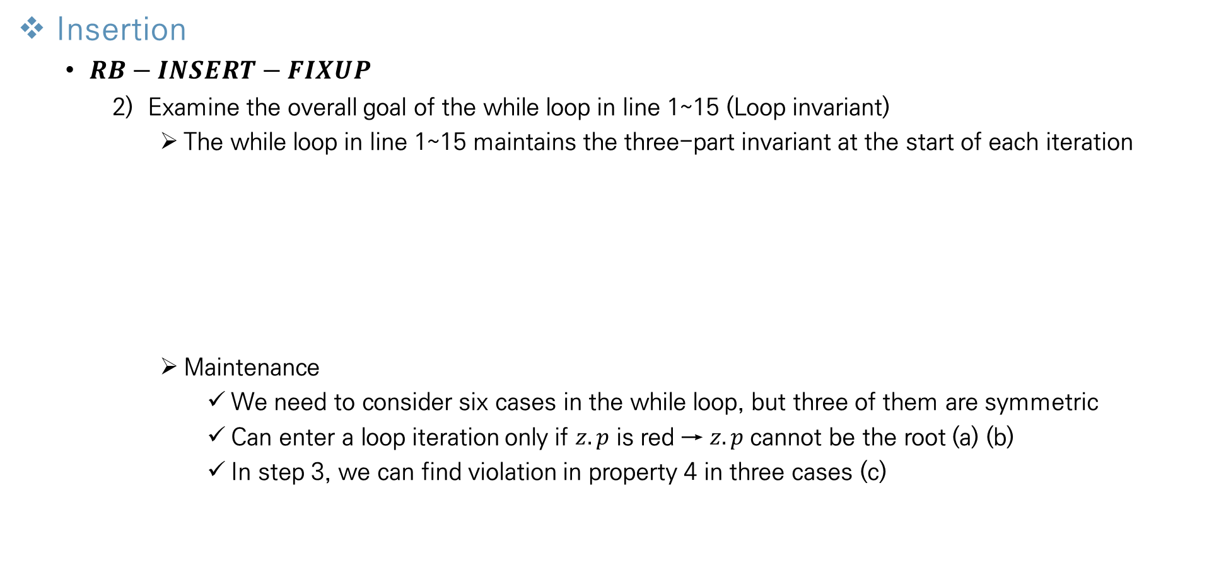
Red-Black Trees
Insertion
$RB−INSERT−FIXUP$
Examine the overall goal of the while loop in line 1~15 (Loop invariant)
The while loop in line 1~15 maintains the three-part invariant at the start of each iteration
Maintenance
We need to consider six cases in the while loop, but three of them are symmetric
Can enter a loop iteration only if $z.p$ is red → $z.p$ cannot be the root (a) (b)
In step 3, we can find violation in property 4 in three cases (c)
About violations

Slide 18
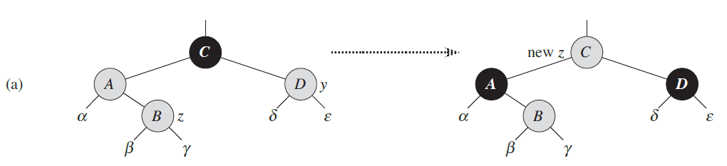

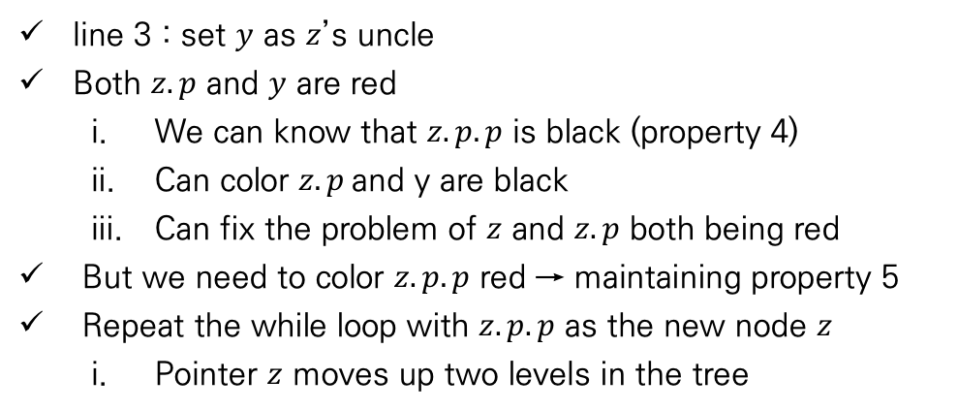
Red-Black Trees
Insertion
$RB−INSERT−FIXUP$
Explore each of three cases within the while loop’s body and how they accomplish the goal
Case 1 – $z$’s uncle $y$ is red
line 3 : set $y$ as $z$’s uncle
Both $z.p$ and $y$ are red
We can know that $z.p.p$ is black (property 4)
Can color $z.p$and y are black
Can fix the problem of $z$ and $z.p$ both being red
But we need to color $z.p.p$ red → maintaining property 5
Repeat the while loop with $z.p.p$ as the new node $z$
Pointer $z$ moves up two levels in the tree

Slide 19
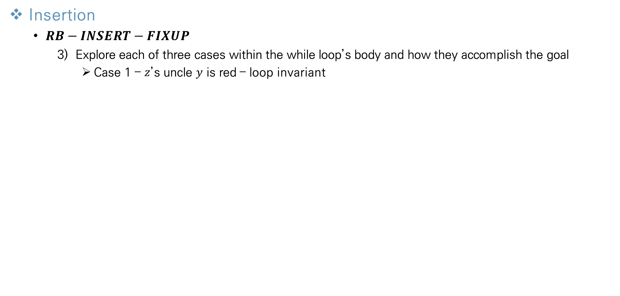
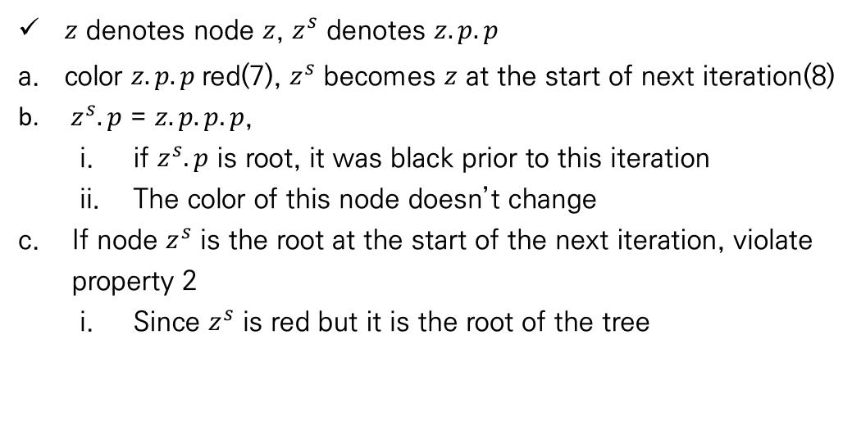
Red-Black Trees
Insertion
$RB−INSERT−FIXUP$
Explore each of three cases within the while loop’s body and how they accomplish the goal
Case 1 – $z$’s uncle $y$ is red – loop invariant
$z$ denotes node $z$, $z^{s}$ denotes $z.p.p$
color $z.p.p$red(7), $z^{s}$ becomes $z$ at the start of next iteration(8)
$z^{s}.p$ = $z.p.p.p$,
if $z^{s}.p$ is root, it was black prior to this iteration
The color of this node doesn’t change
If node $z^{s}$ is the root at the start of the next iteration, violate property 2
Since $z^{s}$ is red but it is the root of the tree

Slide 20
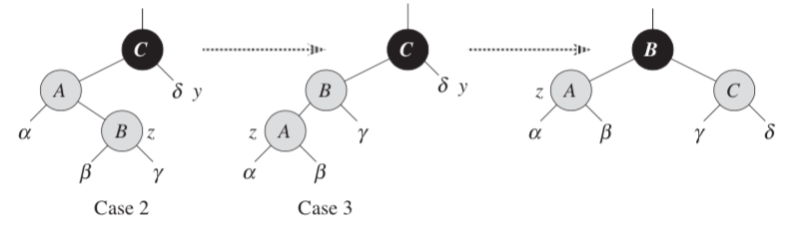

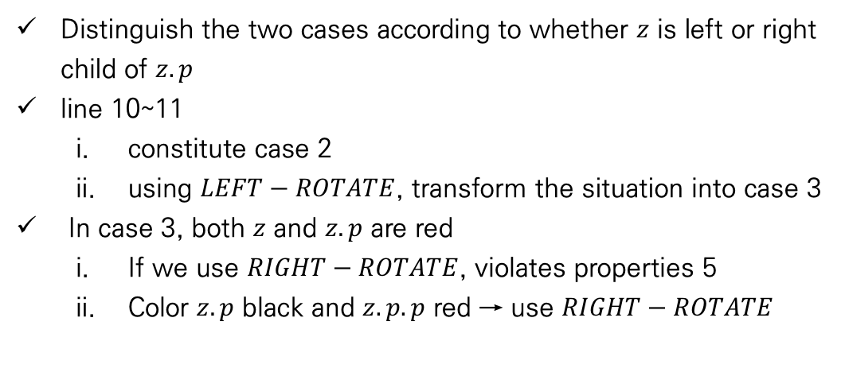
Red-Black Trees
Insertion
$RB−INSERT−FIXUP$
Explore each of three cases within the while loop’s body and how they accomplish the goal
Case 2, 3 – $z$’s uncle $y$ is black and $z$ is a right child(2) or left child(3)
Distinguish the two cases according to whether $z$ is left or right child of $z.p$
line 10~11
constitute case 2
using $LEFT−ROTATE$, transform the situation into case 3
In case 3, both $z$ and $z.p$ are red
If we use $RIGHT−ROTATE$, violates properties 5
Color $z.p$ black and $z.p.p$ red → use $RIGHT−ROTATE$
Black-height

Slide 21





Red-Black Trees
Insertion
The running time of $INSERT$ procedure
The running time of $RB−INSERT$ and $RB−INSERT−FIXUP$ take $O(\lg{n})$ time
$$RB−INSERT$$
$$RB−INSERT−FIXUP$$
Moves from root to leaf
Takes $O\left(h\right)=O(\lg{n})$
Moves from leaf to root
Just change pointer and color attribute
Takes $O\left(h\right)=O(\lg{n})$

Slide 22
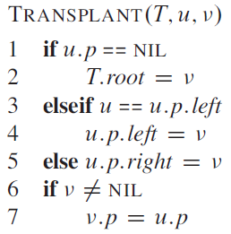
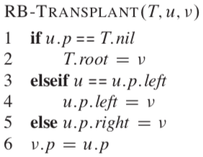
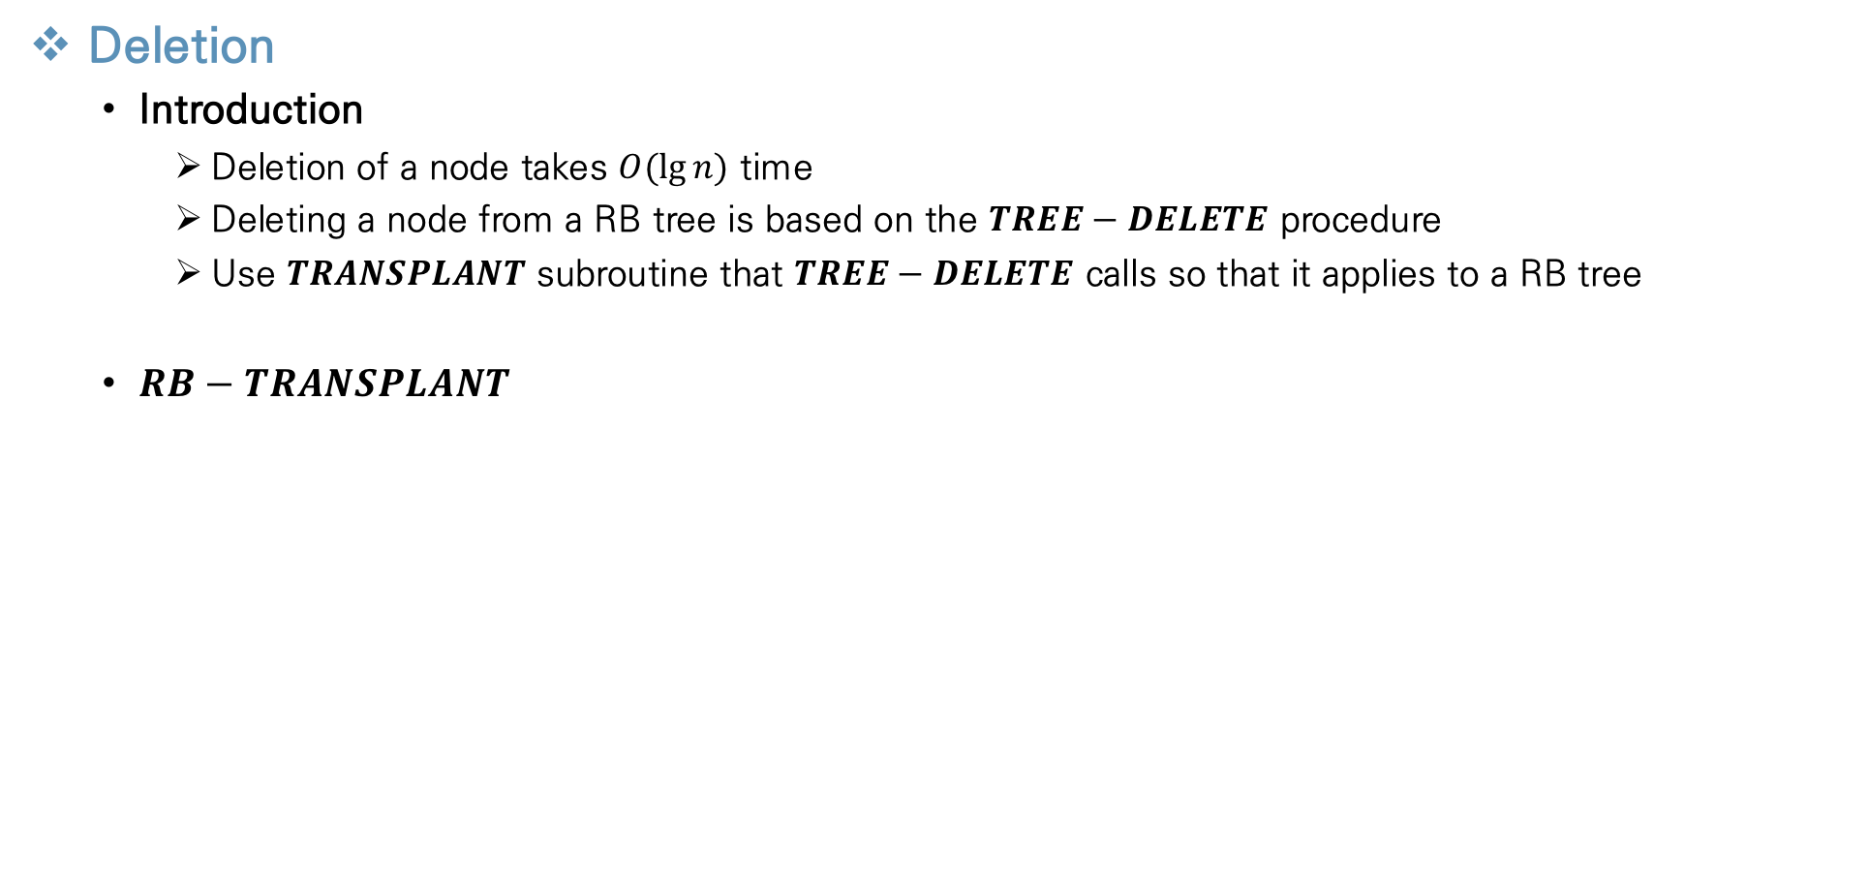
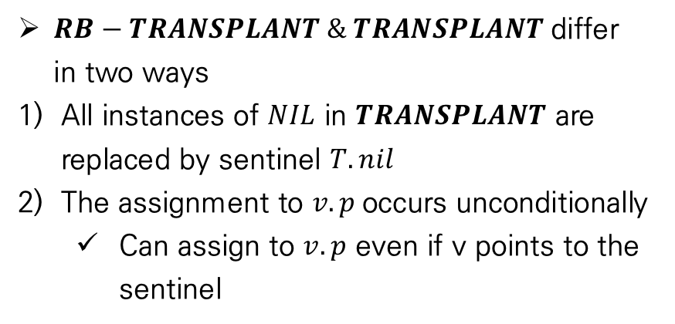
Red-Black Trees
Deletion
Introduction
Deletion of a node takes $O(\lg{n})$ time
Deleting a node from a RB tree is based on the $TREE−DELETE$ procedure
Use $TRANSPLANT$ subroutine that $TREE−DELETE$ calls so that it applies to a RB tree
$RB−TRANSPLANT$
$RB−TRANSPLANT \& TRANSPLANT$differ in two ways
All instances of $NIL$ in $TRANSPLANT$ are replaced by sentinel $T.nil$
The assignment to $v.p$occurs unconditionally
Can assign to $v.p$ even if v points to the sentinel

Slide 23
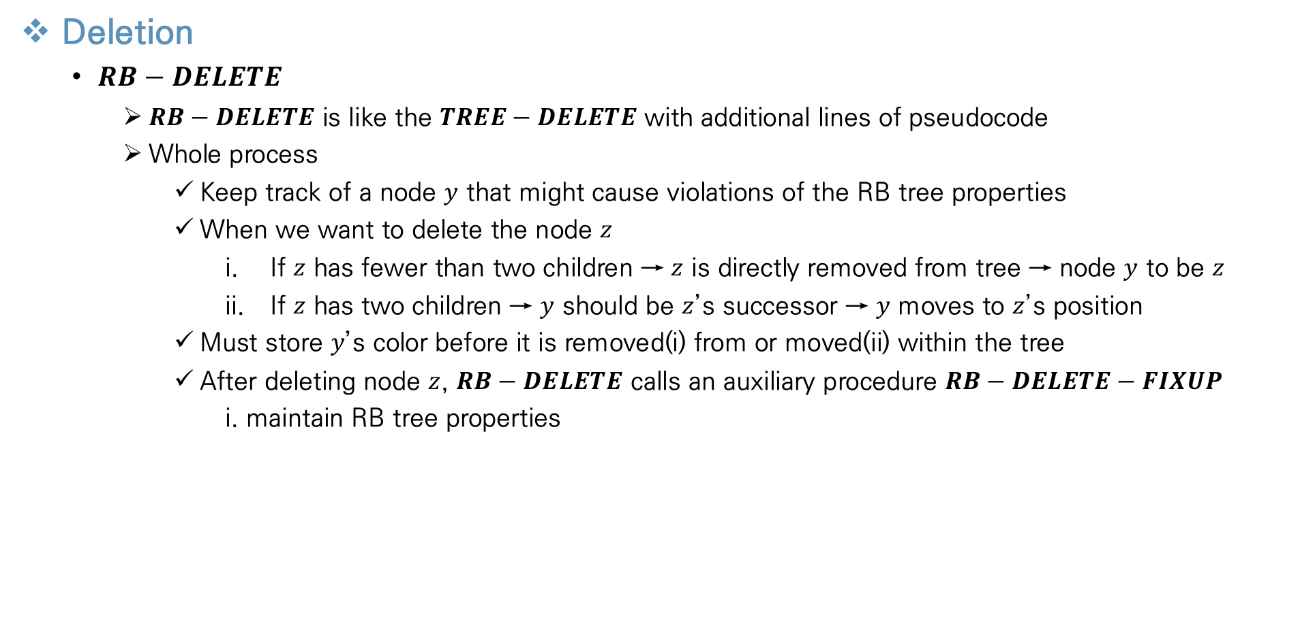
Red-Black Trees
Deletion
$RB−DELETE$
$RB−DELETE$ is like the $TREE−DELETE$ with additional lines of pseudocode
Whole process
Keep track of a node $y$ that might cause violations of the RB tree properties
When we want to delete the node $z$
If $z$ has fewer than two children → $z$ is directly removed from tree → node $y$ to be $z$
If $z$ has two children → $y$ should be $z$’s successor → $y$ moves to $z$’s position
Must store $y$’s color before it is removed(i) from or moved(ii) within the tree
After deleting node $z$, $RB−DELETE$ calls an auxiliary procedure $RB−DELETE−FIXUP$
i. maintain RB tree properties

Slide 24
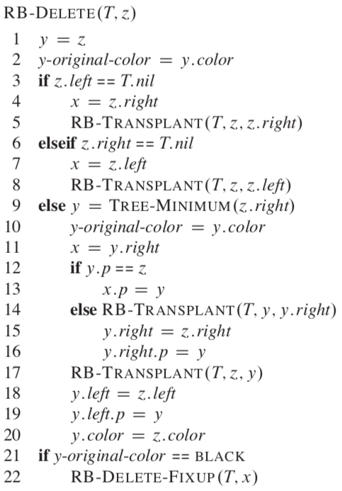
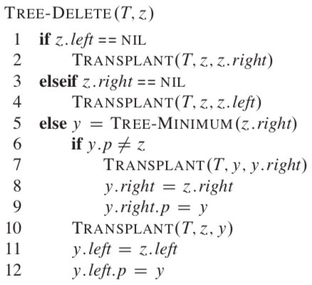

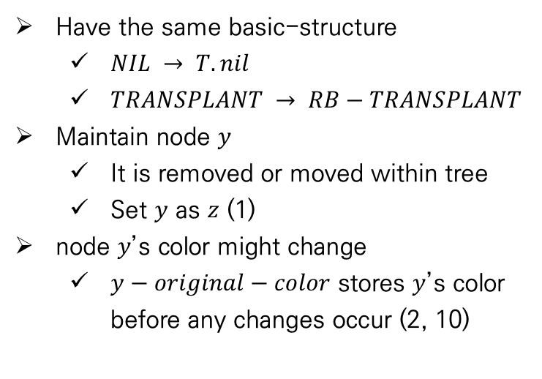
Red-Black Trees
Deletion
$RB−DELETE$ - pseudocode
Have the same basic-structure
$NIL → T.nil$
$TRANSPLANT → RB−TRANSPLANT$
Maintain node $y$
It is removed or moved within tree
Set $y$ as $z$ (1)
node $y$’s color might change
$y−original−color$ stores $y$’s color before any changes occur (2, 10)
Notes:
삭제 과정 간략히 설명

Slide 25
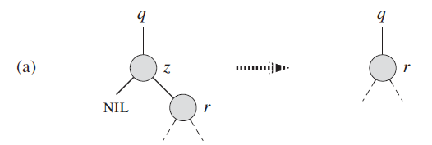
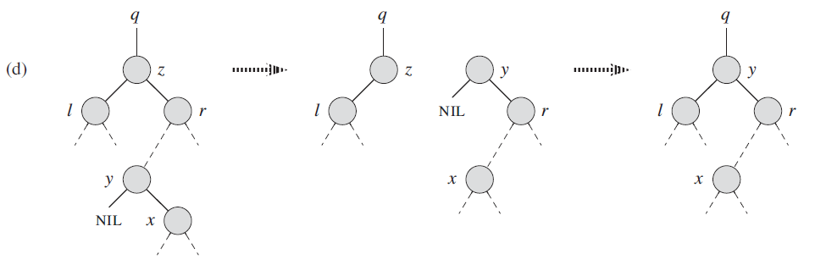
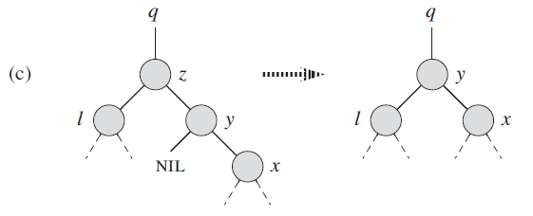
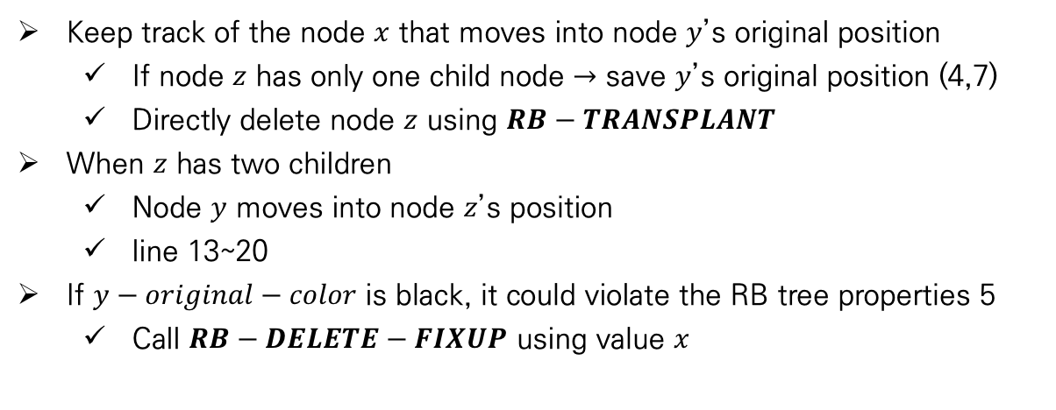
Red-Black Trees
Deletion
$RB−DELETE$ - pseudocode
v
Keep track of the node $x$ that moves into node $y$’s original position
If node $z$ has only one child node $→$ save $y$’s original position (4,7)
Directly delete node $z$ using $RB−TRANSPLANT$
When $z$ has two children
Node $y$ moves into node $z$’s position
line 13~20
If $y−original−color$ is black, it could violate the RB tree properties 5
Call $RB−DELETE−FIXUP$ using value $x$
v
v
v
v
v
v
v
Notes:
삭제 과정 간략히 설명

Slide 26
Thank You!

Slide 27
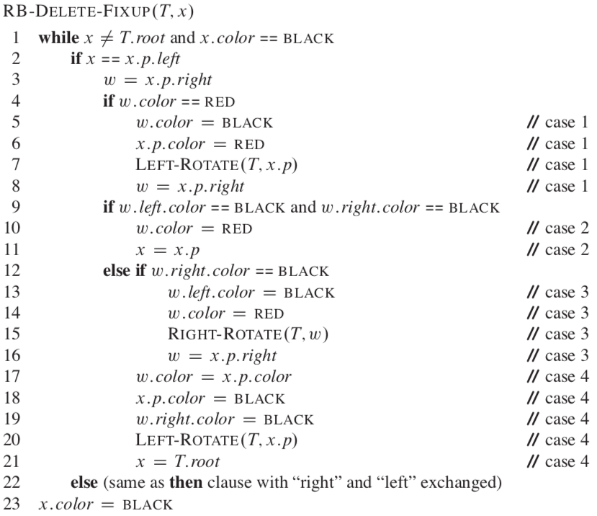
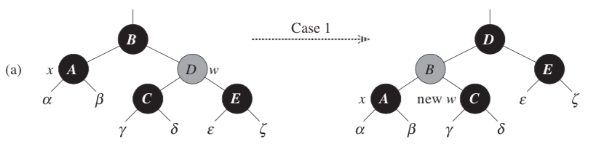


Red-Black Trees
Deletion
$RB−DELETE−FIXUP$ - pseudocode
The pseudocode fixup 4 cases violations
Case 1 : x’s sibling $w$ is red
Switch the colors of $w$ and $x.p$
Perform a left rotation on $x.p$
Move pointer $w$ to $x.p.right$
Transform case 1 to case 2,3,or4
Notes:
삭제 과정 간략히 설명

Slide 28


Red-Black Trees
Deletion
$RB−DELETE−FIXUP$ - pseudocode
The pseudocode fixup 4 cases violations
Case 2 : $x$’s sibling w is black, and both of $w$’s children are black
Change $w$ color as red (10)
Move pointer $x$ to $x.p$ (11)
If new $x$ is black $→$ examine case 1
If new $x$ is red $→$ terminates loop and change to black(23)
Notes:
삭제 과정 간략히 설명

Slide 29


Red-Black Trees
Deletion
$RB−DELETE−FIXUP$ - pseudocode
The pseudocode fixup 4 cases violations
Case 3 : $x$’s sibling w is black, w’s left child is red, and w’s right child is black
Switch color of $w$ and $w.left$(13~14)
Perform a right rotation on $w$ (15)
Move pointer w to $x.p.right$ (16)
Transform case 3 to case 4
Notes:
삭제 과정 간략히 설명

Slide 30


Red-Black Trees
Deletion
$RB−DELETE−FIXUP$ - pseudocode
The pseudocode fixup 4 cases violations
Case 4 : $x$’s sibling $w$ is black, $w$’s left child is red
By making some color changes (17~19)
Perform a left rotation on $x.p$ (20)
Set $x$ to be the root to terminate loop condition (21)
Notes:
삭제 과정 간략히 설명

